Slide 1
Python Training
Advanced

Slide 2
Contents
Programming paradigms in Python
Object Oriented Programming
Glossary

Slide 3
Programming paradigms in Python
Procedural programming
Object-Oriented Programming
Functional programming

Slide 4
Procedural programming
Simply contains a series of computational steps, these steps instruct the computer on how to solve a task in logical stepsBlock structure indicated by indentation
Advantages:-
General-purpose programming
Reusability of the code
It is easy to trace the flow of the program
In [ ]:
#Procedural way of finding sum of a list:
mylist = [10, 20, 30, 40]
def sum_the_list(mylist):
res = 0
for val in mylist:
res += val
return res
print(sum_the_list(mylist))

Slide 5
Object Oriented programming
Objects are the key element of paradigms. Objects can simply be defined as the instance of a class that contains both data members and the method functions. Moreover, the object-oriented style relates data members and methods functions that support encapsulation and with the help of the concept of an inheritance
Advantages:-
Relation with Real world entities
Code reusability
Abstraction or data hiding
In [ ]:
# OOP for finding sum of a list:
# class Emp has been defined here
class Emp:
def __init__(self, name, age):
self.name = name
self.age = age
def info(self):
print("Hello, % s. You are % s old." % (self.name, self.age))
# Objects of class Emp has been made here
Emps = [Emp("John", 43), Emp("Hilbert", 16), Emp("Alice", 30)]
# Objects of class Emp has been used here
for emp in Emps:
emp.info()

Slide 6
Functional programming
Declarative paradigms because it uses declarations overstatements. It uses the mathematical function and treats every statement as functional expression as an expression is executed to produce a value. Lambda functions or Recursion are basic approaches used for its implementation
Advantages:-
Simple to understand
Making debugging and testing easier
Enhances the comprehension and readability of the code
In [ ]:
# Functional way of finding sum of a list
import functools
mylist = [11, 22, 33, 44]
# Recursive Functional approach
def sum_the_list(mylist):
if len(mylist) == 1:
return mylist[0]
else:
return mylist[0] + sum_the_list(mylist[1:])
# lambda function is used
print(functools.reduce(lambda x, y: x + y, mylist))

Slide 7
Graphics to explore the data
Seaborn package is built on matplotlib but provides high level interface for drawing attractive statistical graphics, similar to ggplot2 library in R. It specifically targets statistical data visualization
To show graphs within Python notebook include inline directive:
In [ ]:
%matplotlib inline

Slide 8
Graphics
 | description
distplot | histogram
barplot | estimate of central tendency for a numeric variable
violinplot | similar to boxplot, also shows the probability density of the data
jointplot | Scatterplot
regplot | Regression plot
pairplot | Pairplot
boxplot | boxplot
swarmplot | categorical scatterplot
factorplot | General categorical plot

Slide 9
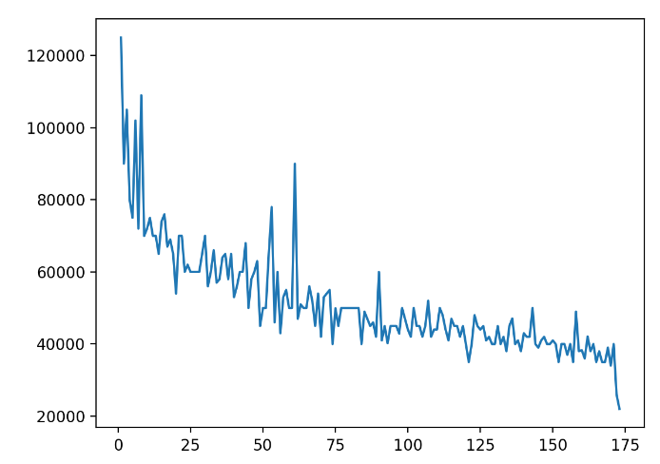
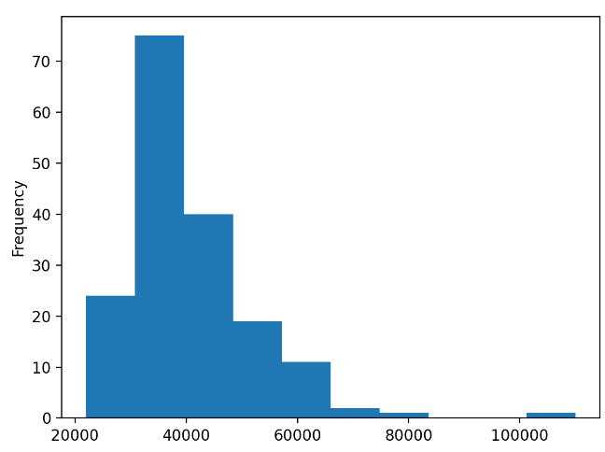
Graphics to explore the data
In [ ]:
# line chart – check for trend
import matplotlib.pyplot as plt
plt.plot(df["Rank"], df["P75th"])
# histogram – check for data distribution
import matplotlib.pyplot as plt
df_column.plot(kind="hist")

Slide 10
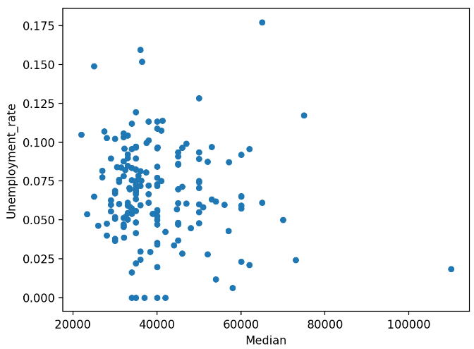
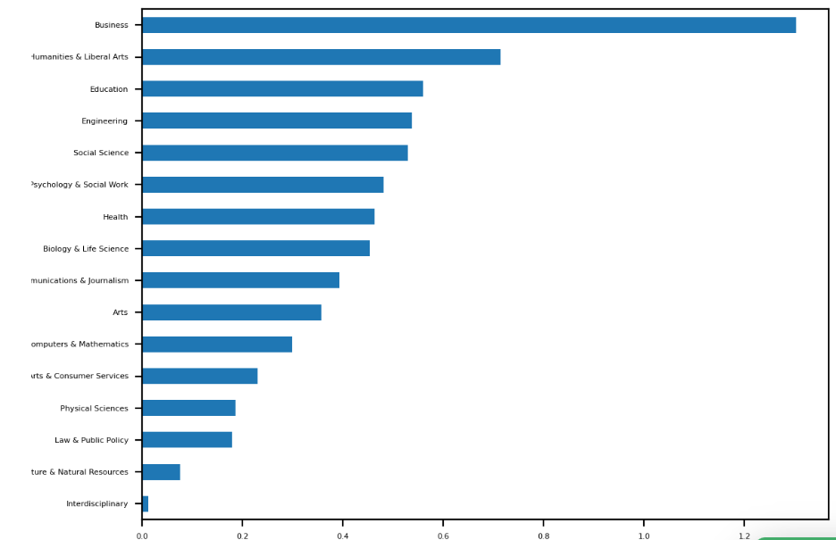
Graphics to explore the data
# bar graph – analyze categorical data
cat_totals.plot(kind="barh", fontsize=4)
In [ ]:
# scatter plot- Check for correlation
df.plot(x="Median", y="Unemployment_rate", kind="scatter")

Slide 11
Glossary

Slide 12
Indentation: the (spaces and tabs [4 spaces]) that are used at the beginning of a statement. The statements with the same indentation belong to the same group called a suite
Nested block: a block of code within another block of code is called a nested block. E.g., nested if else
Debugger: is a computer program used to test and debug other programs
Attributes: function objects that define corresponding methods of its instances
Methods: a method is a function that belongs to an object.
Indexing: referring to an element of an iterable by its position within the iterable. Python indexing starts from 0
Nan: for not a number, is a numeric data type used to represent any value that is undefined or unpresentable
Missing values: values with nan
Argument: information can be passed into functions as arguments. Arguments are specified after the function name, inside the parentheses. You can add as many arguments as you want, just separate them with a comma.

Slide 13
Python OOPs Concepts
An object-oriented paradigm is to design the program using classes and objects. The object is related to real-word entities such as book, house, pencil, etc. The oops concept focuses on writing the reusable code. It is a widespread technique to solve the problem by creating objects.
Major principles of object-oriented programming system are given below.
Class
Object
Method
Inheritance
Polymorphism
Data Abstraction
Encapsulation

Slide 14
Python OOPs Concepts
Class
The class can be defined as a collection of objects. It is a logical entity that has some specific attributes and methods. For example: if you have an employee class, then it should contain an attribute and method, i.e. an email id, name, age, salary, etc.
Object
The object is an entity that has state and behavior. It may be any real-world object like the mouse, keyboard, chair, table, pen, etc.
Everything in Python is an object, and almost everything has attributes and methods. All functions have a built-in attribute __doc__, which returns the docstring defined in the function source code.
class car:
def __init__(self,modelname, year):
self.modelname = modelname
self.year = year
def display(self):
print(self.modelname,self.year)
c1 = car("Toyota", 2016)
c1.display()

Slide 15
Python OOPs Concepts
Method
The method is a function that is associated with an object. In Python, a method is not unique to class instances. Any object type can have methods.
Inheritance
Inheritance is the most important aspect of object-oriented programming, which simulates the real-world concept of inheritance. It specifies that the child object acquires all the properties and behaviors of the parent object.
By using inheritance, we can create a class which uses all the properties and behavior of another class. The new class is known as a derived class or child class, and the one whose properties are acquired is known as a base class or parent class.
It provides the re-usability of the code.

Slide 16
Python OOPs Concepts
Polymorphism
Polymorphism contains two words "poly" and "morphs". Poly means many, and morph means shape. By polymorphism, we understand that one task can be performed in different ways. For example - you have a class animal, and all animals speak. But they speak differently. Here, the "speak" behavior is polymorphic in a sense and depends on the animal. So, the abstract "animal" concept does not actually "speak", but specific animals (like dogs and cats) have a concrete implementation of the action "speak".
Encapsulation
Encapsulation is also an essential aspect of object-oriented programming. It is used to restrict access to methods and variables. In encapsulation, code and data are wrapped together within a single unit from being modified by accident.
Data Abstraction
Data abstraction and encapsulation both are often used as synonyms. Both are nearly synonyms because data abstraction is achieved through encapsulation.
Abstraction is used to hide internal details and show only functionalities. Abstracting something means to give names to things so that the name captures the core of what a function or a whole program does.

Slide 17
Python OOPs Concepts
Index | Object-oriented Programming | Procedural Programming
1. | Object-oriented programming is the problem-solving approach and used where computation is done by using objects. | Procedural programming uses a list of instructions to do computation step by step.
2. | It makes the development and maintenance easier. | In procedural programming, It is not easy to maintain the codes when the project becomes lengthy.
3. | It simulates the real world entity. So real-world problems can be easily solved through oops. | It doesn't simulate the real world. It works on step by step instructions divided into small parts called functions.
4. | It provides data hiding. So it is more secure than procedural languages. You cannot access private data from anywhere. | Procedural language doesn't provide any proper way for data binding, so it is less secure.
5. | Example of object-oriented programming languages is C++, Java, .Net, Python, C#, etc. | Example of procedural languages are: C, Fortran, Pascal, VB etc.

Slide 18
Python OOPs Concepts
class Employee:
id = 10
name = "Devansh"
def display (self):
print(self.id,self.name)
self is used as a reference variable, which refers to the current class object. It is always the first argument in the function definition. However, using self is optional in the function call
Creating an instance of the class
<object-name> = <class-name>(<arguments>)
emp = Employee()
emp.display()
Delete the Object
# Deleting the property of object
del emp.id
# Deleting the object itself
del emp
emp.display()

Slide 19
Python OOPs Concepts
Python Constructor
A constructor is a special type of method (function) which is used to initialize the instance members of the class.
Constructors can be of two types.
Parameterized Constructor
Non-parameterized Constructor
the method the __init__() simulates the constructor of the class. This method is called when the class is instantiated. It accepts the self-keyword as a first argument which allows accessing the attributes or method of the class.
class Student:
count = 0
def __init__(self):
Student.count = Student.count + 1
s1=Student()
s2=Student()
s3=Student()
print("The number of students:",Student.count)

Slide 20
Python OOPs Concepts
class Employee:
def __init__(self, name, id):
self.id = id
self.name = name
def display(self):
print("ID: %d \nName: %s" % (self.id, self.name))
emp1 = Employee("John", 101)
emp2 = Employee("David", 102)
# accessing display() method to print employee 1 information
emp1.display()
# accessing display() method to print employee 2 information
emp2.display()

Slide 21
Python OOPs Concepts
Non-Parameterized Constructor
The non-parameterized constructor uses when we do not want to manipulate the value or the constructor that has only self as an argument. Consider the following example
class Student:
# Constructor - non parameterized
def __init__(self):
print("This is non parametrized constructor")
def show(self,name):
print("Hello",name)
student = Student()
student.show("John")

Slide 22
Python OOPs Concepts
Parameterized Constructor
The parameterized constructor has multiple parameters along with the self. Consider the following example
class Student:
# Constructor - parameterized
def __init__(self, name):
print("This is parametrized constructor")
self.name = name
def show(self):
print("Hello",self.name)
student = Student("John")
student.show()

Slide 23
Python OOPs Concepts
Default Constructor
When we do not include the constructor in the class or forget to declare it, then that becomes the default constructor. It does not perform any task but initializes the objects. Consider the following example.
class Student:
roll_num = 101
name = "Joseph"
def display(self):
print(self.roll_num,self.name)
st = Student()
st.display()

Slide 24
Python OOPs Concepts
More than One Constructor in Single class
Let's have a look at another scenario, what happen if we declare the two same constructors in the class.
Example
class Student:
def __init__(self):
print("The First Constructor")
def __init__(self):
print("The second contructor")
st = Student()
Output:
the object st called the second constructor whereas both have the same configuration. The first method is not accessible by the st object. Internally, the object of the class will always call the last constructor if the class has multiple constructors

Slide 25
Python OOPs Concepts
built-in class functions
The built-in functions defined in the class are described in the following table.
SN | Function | Description
1 | getattr(obj,name,default) | It is used to access the attribute of the object.
2 | setattr(obj, name,value) | It is used to set a particular value to the specific attribute of an object.
3 | delattr(obj, name) | It is used to delete a specific attribute.
4 | hasattr(obj, name) | It returns true if the object contains some specific attribute.

Slide 26
Python OOPs Concepts
class Student:
def __init__(self, name, id, age):
self.name = name
self.id = id
self.age = age
# creates the object of the class Student
s = Student("John", 101, 22)
# prints the attribute name of the object s
print(getattr(s, 'name'))
# reset the value of attribute age to 23
setattr(s, "age", 23)
# prints the modified value of age
print(getattr(s, 'age'))
# prints true if the student contains the attribute with name id
print(hasattr(s, 'id'))
# deletes the attribute age
delattr(s, 'age')
# this will give an error since the attribute age has been deleted
print(s.age)

Slide 27
Python OOPs Concepts
Built-in class attributes
Along with the other attributes, a Python class also contains some built-in class attributes which provide information about the class.
The built-in class attributes are given in the below table.
SN | Attribute | Description
1 | __dict__ | It provides the dictionary containing the information about the class namespace.
2 | __doc__ | It contains a string which has the class documentation
3 | __name__ | It is used to access the class name.
4 | __module__ | It is used to access the module in which, this class is defined.
5 | __bases__ | It contains a tuple including all base classes.

Slide 28
Python OOPs Concepts
Example
class Student:
def __init__(self,name,id,age):
self.name = name;
self.id = id;
self.age = age
def display_details(self):
print("Name:%s, ID:%d, age:%d"%(self.name,self.id))
s = Student("John",101,22)
print(s.__doc__)
print(s.__dict__)
print(s.__module__)

Slide 29
Python OOPs Concepts
Inheritance
class derived-class(base class):
<class-suite>
class derive-class(<base class 1>, <base class 2>, ..... <base class n>):
<class - suite>
class Animal:
def speak(self):
print("Animal Speaking")
#child class Dog inherits the base class Animal
class Dog(Animal):
def bark(self):
print("dog barking")
d = Dog()
d.bark()
d.speak()

Slide 30
Python OOPs Concepts
Multi-Level inheritance
Multi-Level inheritance is possible in python like other object-oriented languages. Multi-level inheritance is archived when a derived class inherits another derived class. There is no limit on the number of levels up to which, the multi-level inheritance is archived in python
class class1:
<class-suite>
class class2(class1):
<class suite>
class class3(class2):
<class suite>
class Animal:
def speak(self):
print("Animal Speaking")
#The child class Dog inherits the base class Animal
class Dog(Animal):
def bark(self):
print("dog barking")
#The child class Dogchild inherits another child class Dog
class DogChild(Dog):
def eat(self):
print("Eating bread...")
d = DogChild()
d.bark()
d.speak()
d.eat()

Slide 31
Python OOPs Concepts
Multiple inheritance
Python provides us the flexibility to inherit multiple base classes in the child class
class Calculation1:
def Summation(self,a,b):
return a+b;
class Calculation2:
def Multiplication(self,a,b):
return a*b;
class Derived(Calculation1,Calculation2):
def Divide(self,a,b):
return a/b;
d = Derived()
print(d.Summation(10,20))
print(d.Multiplication(10,20))
print(d.Divide(10,20))

Slide 32
Python OOPs Concepts
The issubclass(sub,sup) method
The issubclass(sub, sup) method is used to check the relationships between the specified classes. It returns true if the first class is the subclass of the second class, and false otherwise
class Calculation1:
def Summation(self,a,b):
return a+b;
class Calculation2:
def Multiplication(self,a,b):
return a*b;
class Derived(Calculation1,Calculation2):
def Divide(self,a,b):
return a/b;
d = Derived()
print(issubclass(Derived,Calculation2))
print(issubclass(Calculation1,Calculation2))

Slide 33
Python OOPs Concepts
The isinstance (obj, class) method
The isinstance() method is used to check the relationship between the objects and classes. It returns true if the first parameter, i.e., obj is the instance of the second parameter, i.e., class
class Calculation1:
def Summation(self,a,b):
return a+b;
class Calculation2:
def Multiplication(self,a,b):
return a*b;
class Derived(Calculation1,Calculation2):
def Divide(self,a,b):
return a/b;
d = Derived()
print(isinstance(d,Derived))

Slide 34
Python OOPs Concepts
Method Overriding
We can provide some specific implementation of the parent class method in our child class. When the parent class method is defined in the child class with some specific implementation, then the concept is called method overriding. We may need to perform method overriding in the scenario where the different definition of a parent class method is needed in the child class.
class Animal:
def speak(self):
print("speaking")
class Dog(Animal):
def speak(self):
print("Barking")
d = Dog()
d.speak()
class Bank:
def getroi(self):
return 10;
class SBI(Bank):
def getroi(self):
return 7;
class ICICI(Bank):
def getroi(self):
return 8;
b1 = Bank()
b2 = SBI()
b3 = ICICI()
print("Bank Rate of interest:",b1.getroi());
print("SBI Rate of interest:",b2.getroi());
print("ICICI Rate of interest:",b3.getroi());

Slide 35
Python OOPs Concepts
Data abstraction in python
Abstraction is an important aspect of object-oriented programming. In python, we can also perform data hiding by adding the double underscore (___) as a prefix to the attribute which is to be hidden. After this, the attribute will not be visible outside of the class through the object.
class Employee:
__count = 0;
def __init__(self):
Employee.__count = Employee.__count+1
def display(self):
print("The number of employees",Employee.__count)
emp = Employee()
emp2 = Employee()
try:
print(emp.__count)
finally:
emp.display()

Slide 36
Python OOPs Concepts
Abstraction in Python
Abstraction is used to hide the internal functionality of the function from the users. The users only interact with the basic implementation of the function, but inner working is hidden. User is familiar with that "what function does" but they don't know "how it does.“
Why Abstraction is Important?
In Python, an abstraction is used to hide the irrelevant data/class in order to reduce the complexity. It also enhances the application efficiency. Next, we will learn how we can achieve abstraction using the Python program.
Abstraction classes in Python
In Python, abstraction can be achieved by using abstract classes and interfaces.
A class that consists of one or more abstract method is called the abstract class. Abstract methods do not contain their implementation. Abstract class can be inherited by the subclass and abstract method gets its definition in the subclass. Abstraction classes are meant to be the blueprint of the other class. An abstract class can be useful when we are designing large functions. An abstract class is also helpful to provide the standard interface for different implementations of components. Python provides the abc module to use the abstraction in the Python program.

Slide 37
Python OOPs Concepts
Abstract Base Classes
An abstract base class is the common application program of the interface for a set of subclasses. It can be used by the third-party, which will provide the implementations such as with plugins. It is also beneficial when we work with the large code-base hard to remember all the classes.
Working of the Abstract Classes
Unlike the other high-level language, Python doesn't provide the abstract class itself. We need to import the abc module, which provides the base for defining Abstract Base classes (ABC). The ABC works by decorating methods of the base class as abstract. It registers concrete classes as the implementation of the abstract base. We use the @abstractmethod decorator to define an abstract method or if we don't provide the definition to the method, it automatically becomes the abstract method.
# Python program demonstrate
# abstract base class work
from abc import ABC, abstractmethod
class Car(ABC):
def mileage(self):
pass
class Tesla(Car):
def mileage(self):
print("The mileage is 30kmph")
class Suzuki(Car):
def mileage(self):
print("The mileage is 25kmph ")
class Duster(Car):
def mileage(self):
print("The mileage is 24kmph ")
class Renault(Car):
def mileage(self):
print("The mileage is 27kmph ")
# Driver code
t= Tesla ()
t.mileage()
r = Renault()
r.mileage()
s = Suzuki()
s.mileage()
d = Duster()
d.mileage()

Slide 38
Python OOPs Concepts
Points to Remember
Below are the points which we should remember about the abstract base class in Python.
An Abstract class can contain the both method normal and abstract method.
An Abstract cannot be instantiated; we cannot create objects for the abstract class.
Decorator
Decorators are one of the most helpful and powerful tools of Python. These are used to modify the behavior of the function. Decorators provide the flexibility to wrap another function to expand the working of wrapped function, without permanently modifying it.
It is also called meta programming where a part of the program attempts to change another part of program at compile time.
Decorating functions with parameters
def divide(x,y):
print(x/y)
def outer_div(func):
def inner(x,y):
if(x<y):
x,y = y,x
return func(x,y)
return inner
divide1 = outer_div(divide)
divide1(2,4)

Slide 39
Python OOPs Concepts
Syntactic Decorator
In the above program, we have decorated out_div() that is little bit bulky. Instead of using above method, Python allows to use decorator in easy way with @symbol
def outer_div(func):
def inner(x,y):
if(x<y):
x,y = y,x
return func(x,y)
return inner
# syntax of decorator
@outer_div
def divide(x,y):
print(x/y)

Slide 40
Python OOPs Concepts
Python Generator
Python Generators are the functions that return the traversal object and used to create iterators. It traverses the entire items at once. The generator can also be an expression in which syntax is similar to the list comprehension in Python.
There is a lot of complexity in creating iteration in Python; we need to implement __iter__() and __next__() method to keep track of internal states.
Create Generator function in Python
It is similar to the normal function defined by the def keyword and uses a yield keyword instead of return. Or we can say that if the body of any function contains a yield statement, it automatically becomes a generator function
def simple():
for i in range(10):
if(i%2==0):
yield i
#Successive Function call using for loop
for i in simple():
print(i)

Slide 41
Python OOPs Concepts
yield vs. return
The yield statement is responsible for controlling the flow of the generator function. It pauses the function execution by saving all states and yielded to the caller. Later it resumes execution when a successive function is called. We can use the multiple yield statement in the generator function.
The return statement returns a value and terminates the whole function and only one return statement can be used in the function.
def multiple_yield():
str1 = "First String"
yield str1
str2 = "Second string"
yield str2
str3 = "Third String"
yield str3
obj = multiple_yield()
print(next(obj))
print(next(obj))
print(next(obj))

Slide 42
Python OOPs Concepts
Difference between Generator function and Normal function
Normal function contains only one Lreturn statement whereas generator function can contain one or more yield statement.
When the generator functions are called, the normal function is paused immediately and control transferred to the caller.
Local variable and their states are remembered between successive calls.
StopIteration exception is raised automatically when the function terminates.
list = [1,2,3,4,5,6,7]
# List Comprehension
z = [x**3 for x in list]
# Generator expression
a = (x**3 for x in list)
print(a)
print(z)

Slide 43
Python OOPs Concepts
list = [1,2,3,4,5,6]
z = (x**3 for x in list)
print(next(z))
print(next(z))
print(next(z))
print(next(z))
def table(n):
for i in range(1,11):
yield n*i
i = i+1
for i in table(15):
print(i)

